Slide 1
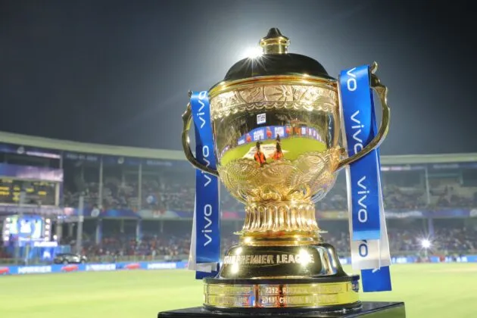

ipl 2022 data analysis by ketul
IPL study of data to extract information and insights from data and apply knowledge to get actionable insights

Slide 2
1. Useful Important steps
Step-01 := Import useful library
Step-02:= connect file to python
Step-03:= removing unwanted values from the data
Step-04:= understand basics of our data, EDA (i.e. data shape,data info,describe data,total columns name)
Step-05:= Extract useful details from main column (i.e date column extract year and month, Address column extract city)

Slide 3
CLEANING DATA
Cleaning data is most useful teams in data analysis removing unwanted stuff is helps us to improve data information accuracy
So, finding first is there any NULL or NAN values in column or rows
I have two main table for Analise our data
(1) Match information data (2) ball to ball data
Importing a useful library for analyze our data easily , in here I am using important libraries:
Numpy
Pandas
Matplotlib
Seaborn

Slide 4
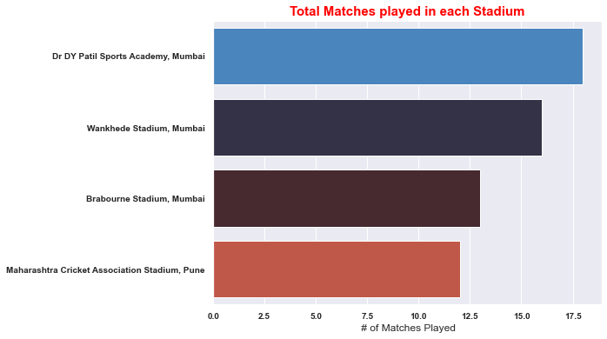
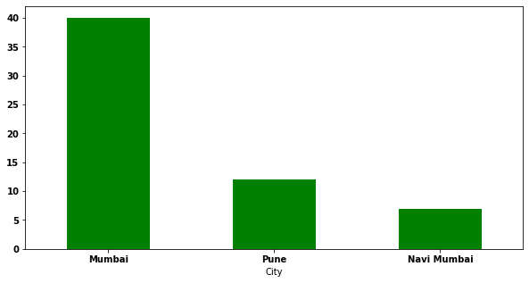
1. How many matches played in season 2022? 2. How many matches played in each stadium?
Total 59 matches were played in this season
Dr DY Patil Sports Academy, Mumbai -----------→ 18
Wankhede Stadium, Mumbai -------------------→ 16
Brabourne Stadium, Mumbai ------------------→ 13
Maharashtra Cricket Association Stadium, Pune → 12
Most of the matched were played in Mumbai
Top Most matches played in Dy patil sports stadium

Slide 5
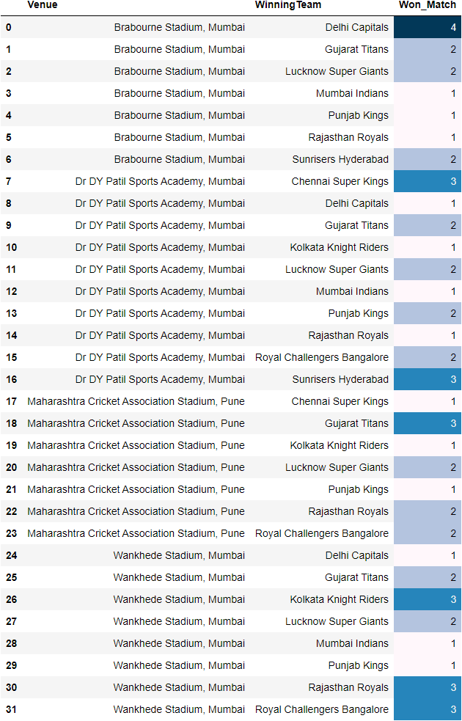
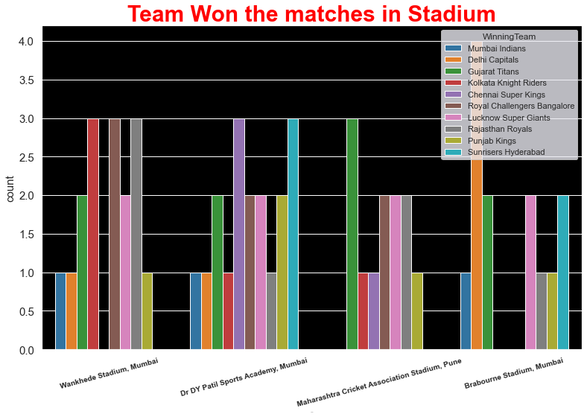
3. In which stadium ,which team most of the matches had won
Delhi capitals most of times won in Brabourne stadium in Wankhede, 3 team had perform well (kkr,rcb,rr) compared to other stadiums

Slide 6
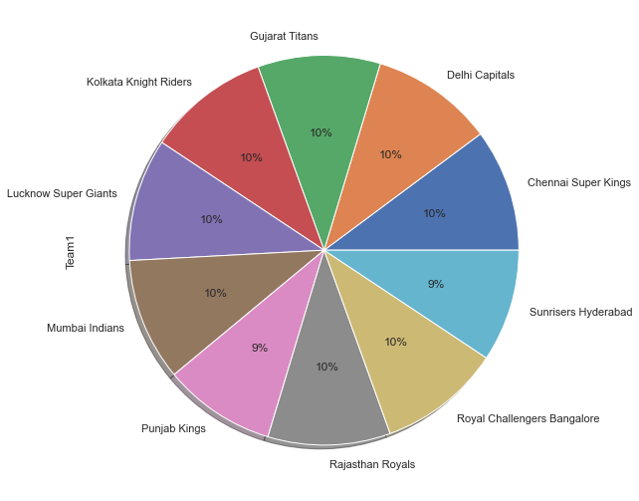
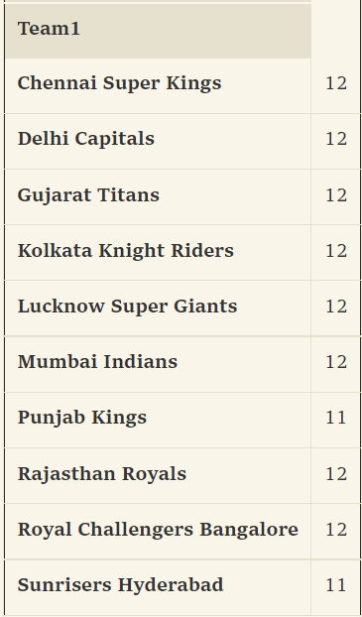
4. how many matches were played by each team?
Overall all team played around equal matches

Slide 7
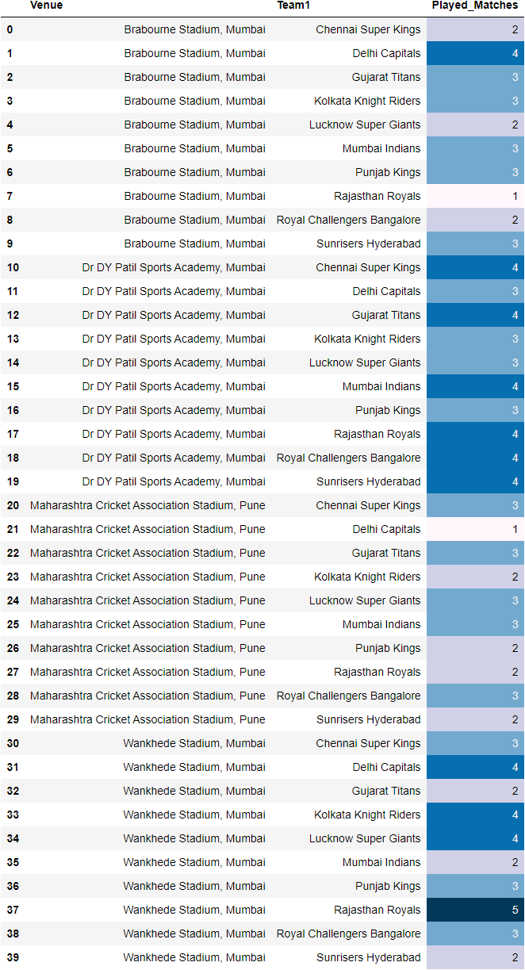
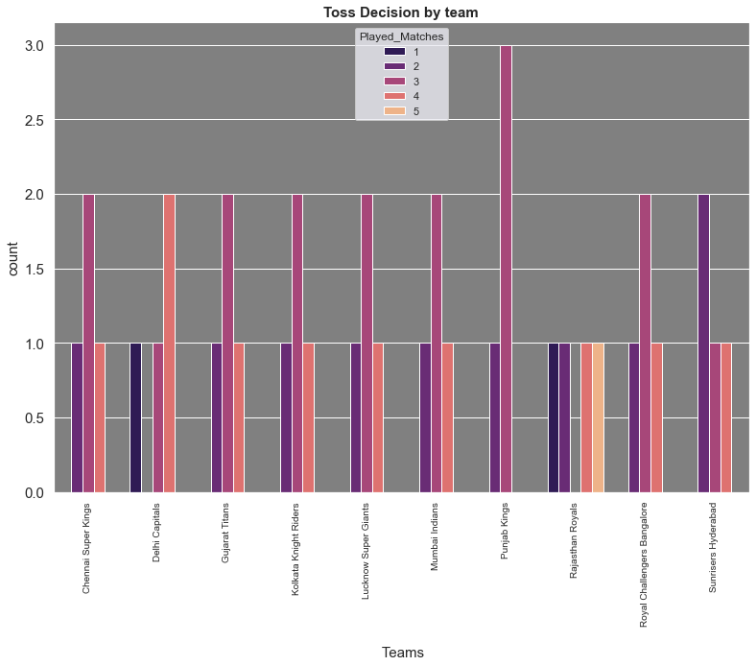
5. In which stadium how many matches were played by each team ?
Punjab 3 times played match in same stadium

Slide 8
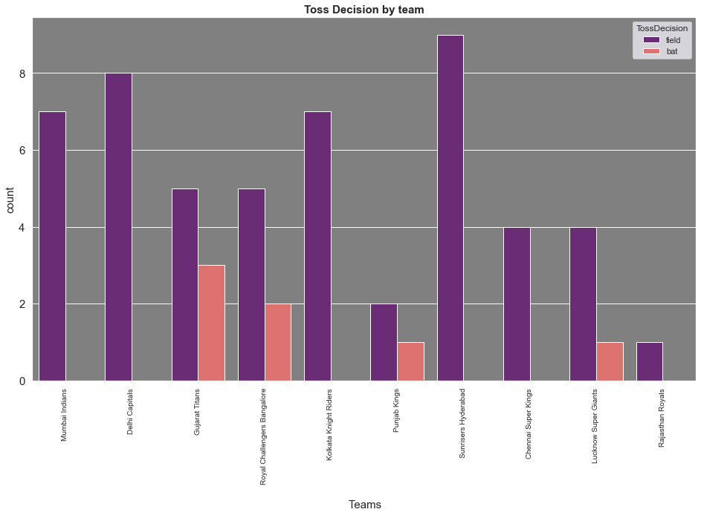
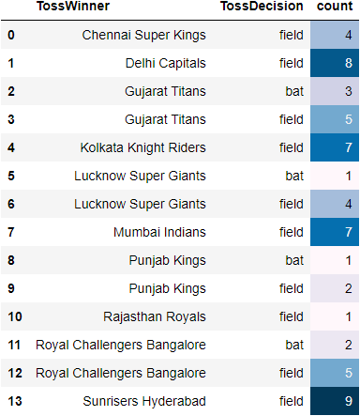
Q6. Toss Decision by Team
In the Most of cases team chose field first
Hyderabad won the toss most

Slide 9
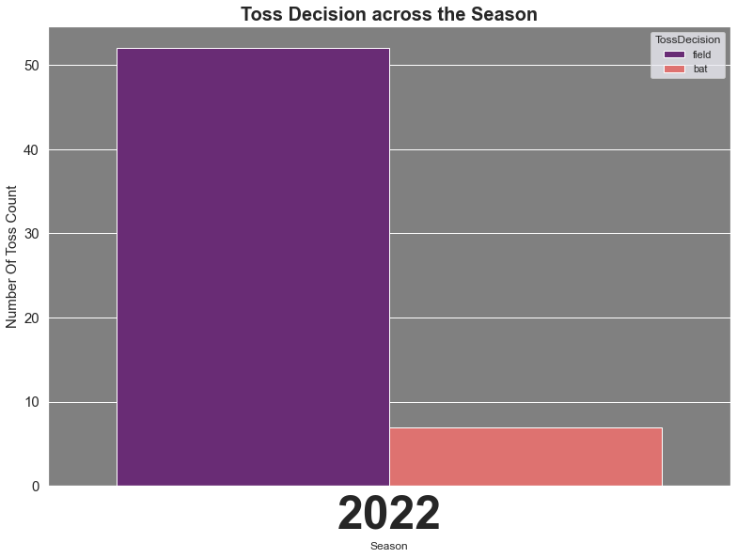
Q7. What is the toss decision in this season?
In season 2022, Most of the team chose ball first

Slide 10
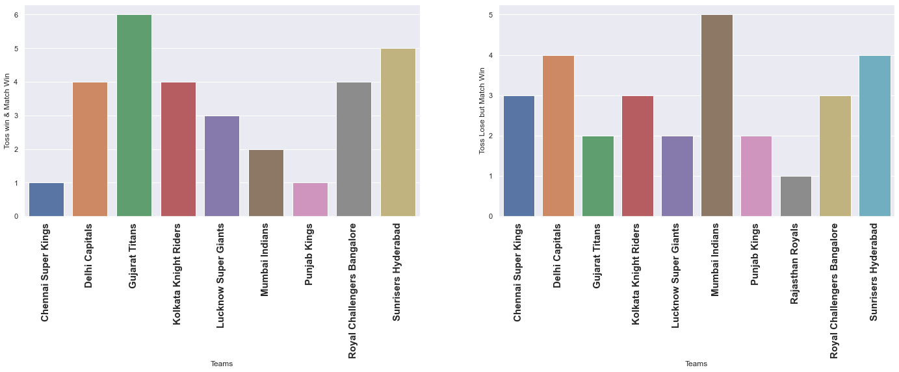
Q8. Winning The match after toss
Graph-01 represents, Team win the match after won the toss
We can predict that if GT won the toss,50% chances to win the match compared to other team
Graph-02 represents, Team win the match after lose the toss
Most of cases ,MI won the matches 5 times even they lost the toss
Graph -01
Graph -02

Slide 11
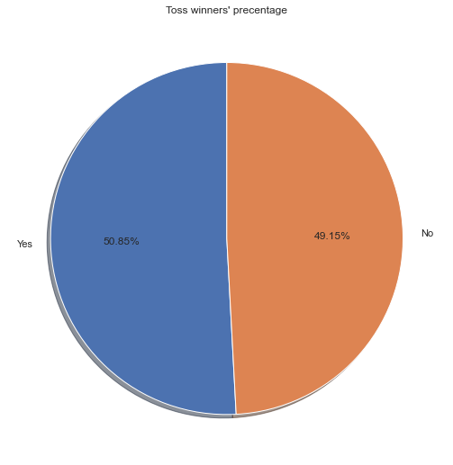
Q9. Win - lose ratio after win the toss
Avg 50%-50% ratio, if any team won or lost the toss

Slide 12
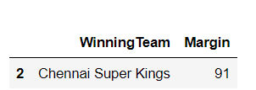
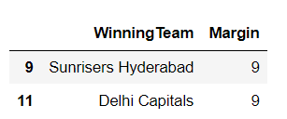
Q10. (I) Won the match with biggest margin (ii) Won the match with biggest Wickets
Chennai Super King has won the match with biggest margin
Out of the 10 team only 2 team has won the match without drop any wicket

Slide 13

Q11. How many Super-over played in this season? If any super over than Who had won?
In this season, between two innings one team won the match
There is no such a case for match tie

Slide 14

Q12. which player most of times man of match in this season?
Most of the times Kuldeep Yadav won the man of the match

Slide 15
Q13. The Lowest total defended and Highest total chased by each team
Lucknow Team won the match for chasing big score in the Brabourne stadium
Lucknow Team has not chassed minimum score in the tournament

Slide 16
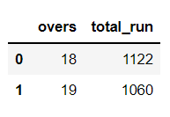
Qn-14 Most runs scored in 20th and19th overs

Slide 17
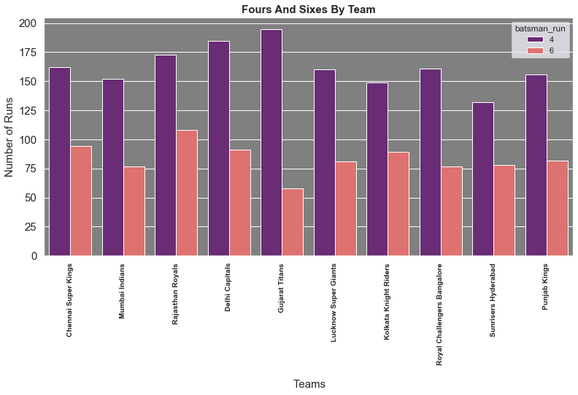
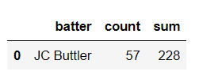


Q15. Most Sixes and Most Four by individual and teams
Buttler hits many sixe and fours in this tournament
Almost double fours smashed in this tournament

Slide 18
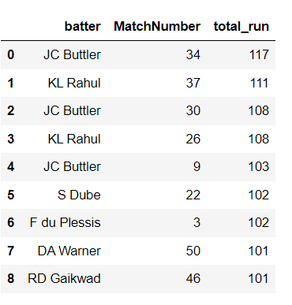
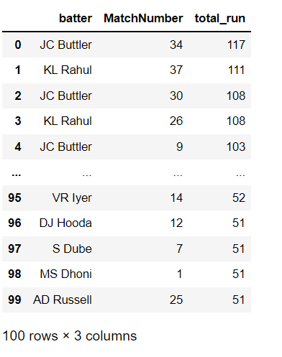
Q16. > 50 Score by player and > 100 Score by player
Score > 100
Score > 50

Slide 19

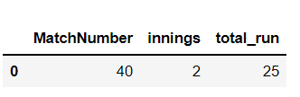
Q17. Highest Run scorer in power play and death overs
Power Play score
Last Over score

Slide 20
Thank you

